Slide 1
PBL GROUP4
Osaka: YUKI,TAKERU
Taiwan: PETE, BRUCE, ERIC, PONNIE, SHIN

Slide 2
WORK PROGRESS
HARD WARE
Ball catcher
SOFTWARE
Ultrasonic sensor
Camera
Servo motor

Slide 3
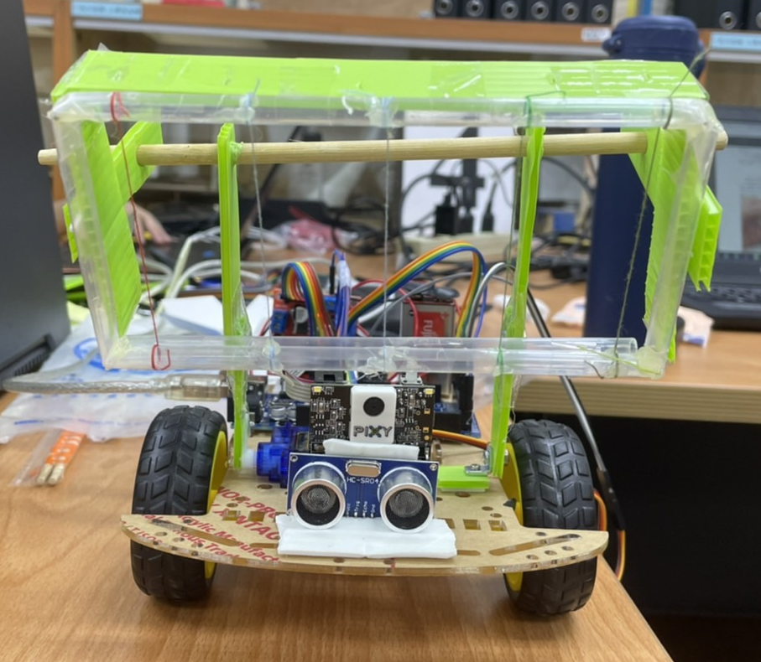
Ball Catcher - Front

Slide 4
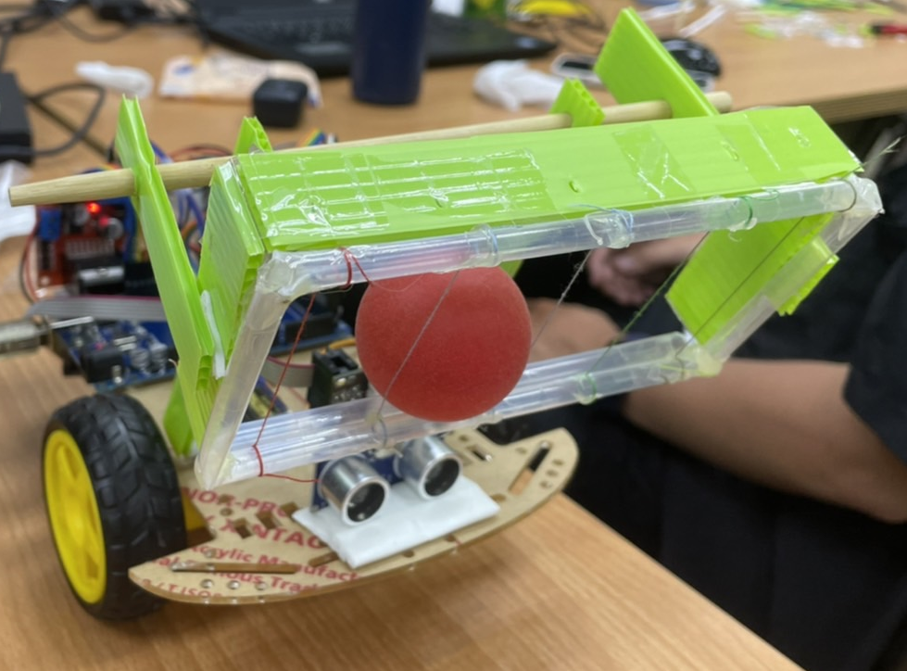
Ball Catcher - Right front

Slide 5
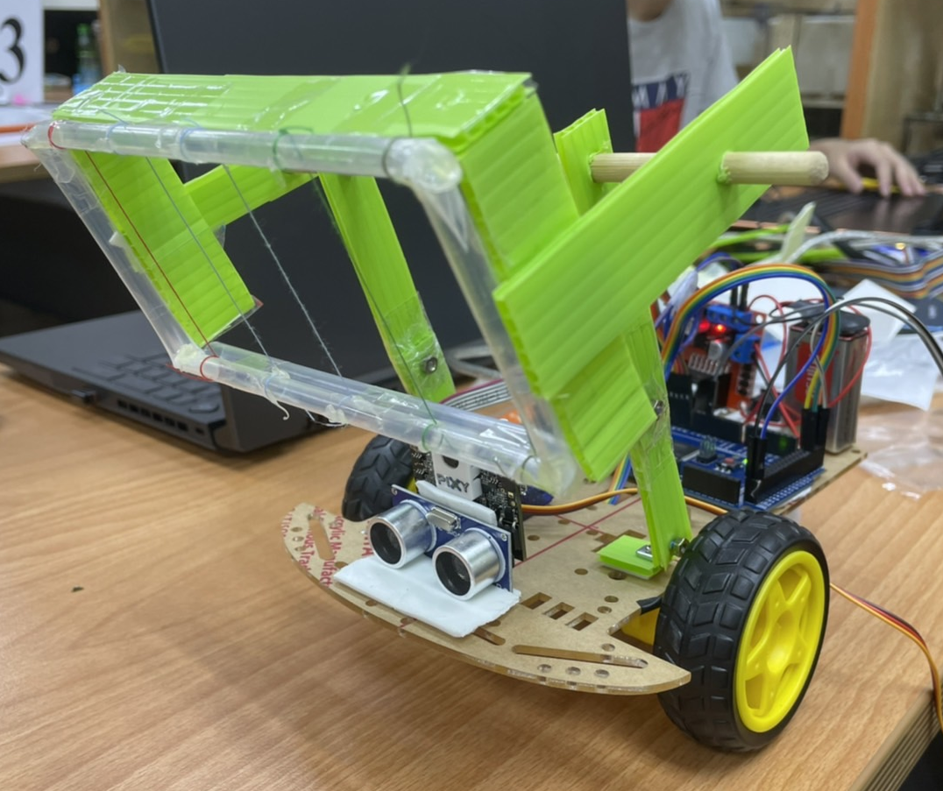
Ball Catcher - Left front

Slide 6
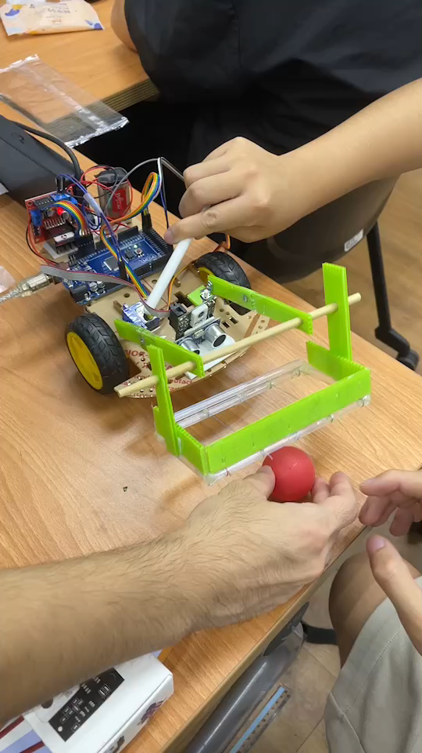
Ball catcher & Servo motor

Slide 7
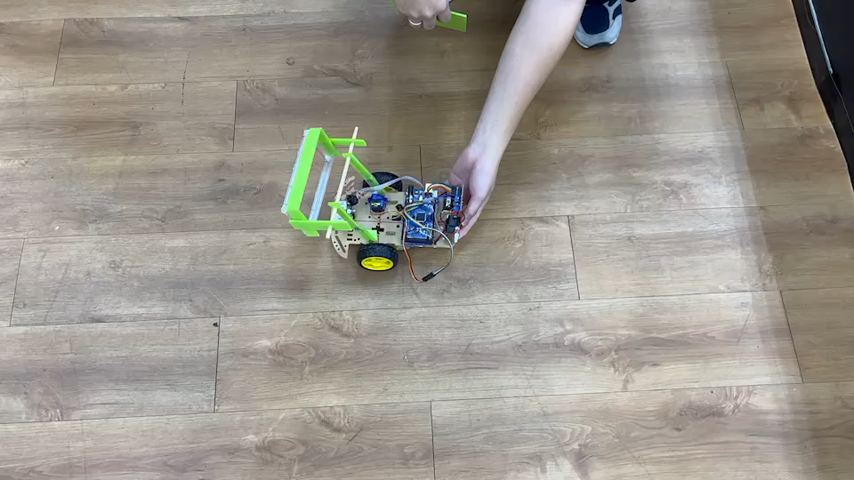
Ultrasonic sensor

Slide 8
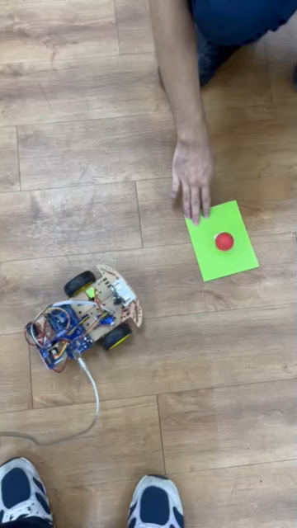
Camera

Slide 9
Tomorrow Plan
Finish the ball container.
Track the ball more precisely.
Design our strategy about the map.
Combine all the code and try to run it.

Slide 10
The end.

